Slide 1
Please complete the University Course Eval! https://tamu.aefis.net
Should take only 2-10 minutes, depending on whether you are willing to leave comments, too. I hope you will, and the more specific, the better.
My Promise: If you leave comments, I WILL READ them. Previous student comments have led me to change my course design in big and small ways.

Slide 2
Tough Issues & State Policy
Chapter 12B, Part 1
Tough Issue #2: Healthcare (Part 1)
Dr. Dwight Roblyer
…I’ve discovered that this topic is a lot like taxes: most college students don’t know much about it because they haven’t yet had to deal with it personally
So dig in
Ask questions
Fight for understanding

Slide 3
Learning Objectives:
Describe the difference between viewing healthcare as a privilege vs. a right.
Compare and contrast the private care model and the socialized care model.
Explain how most Americans that can afford healthcare manage to do so.
Describe how healthcare insurance works in general.
Explain what healthcare insurance companies must consider carefully to stay in business.
List and explain the various costs associated with healthcare insurance and how these usually vary with low-cost vs. high-cost policies.
Explain how individuals with healthcare insurance can still end up paying directly for some of their healthcare.
Calculate the monthly healthcare costs for 4 months for the individual with the HDP policy on Slide 13. Specify each of the categories into which these costs fall: premium, deductible, co-pay, and out-of-pocket. If it helps, use the bucket concept from the Consumer Reports video.
Use a deductible of $1500, a monthly cost of $150 for medications, and the $650 urgent-care visit in month 2 only.
Use a deductible of $3000, a monthly cost of $150 for medications, and the $650 urgent-care visit in months 1, 3, and 4.
Repeat “b)”, but use a deductible of $500.

Slide 4
Learning Objectives:
Use the numbers you calculated in #8 to explain the risks of HDP health insurance.
Using the 2013 Milliman Medical Index, describe the different parts of the breakdown of the annual medical costs for a middle-class family of four, and who pays for each part. Characterize the overall and component costs.
Explain the nature and size of the increase in medical costs for that same notional family between 2002 and 2013.
Describe the percentage of Americans with unpaid medical bills and the relationship between these bills and personal bankruptcies in the US.
Explain the trend between 2008 and 2012 in how Americans were obtaining or forgoing health insurance. Describe the possible role of the Great Recession in those trends.
Compare and contrast the 2008-2012 picture with the 2001-2017 trends in types of health insurance and who pays for it.
Describe how types of jobs, and types of healthcare plans affect the availability of affordable, high-quality healthcare for Americans.

Slide 5
What’s Up? What would you expect to pay for a “major medical” Emergency Room visit? (e.g., gallbladder problem that doesn’t result in surgery)
$3000-$5000
$10,000-$20,000
$45,000-$70,000
$90,000-$115,000+

Slide 6
What’s Up? What would you expect to pay for a “major medical” Emergency Room visit? (e.g., gallbladder problem that doesn’t result in surgery)
Answer depends on a lot of different things:
How did you get to the ER?
Is it a standalone or hospital ER?
If hospital, is it private or public?
How many tests were ordered?
What imaging was ordered?
How many specialists consulted?
Were you given oxygen? Meds?
$3000-$5000
$10,000-$20,000
$45,000-$70,000
$90,000-$115,000+

Slide 7
What’s the issue? Cost!
Medical care in the U.S. is expensive and functions more as a “privilege” than as a “right”
If you have (money, insurance), then you can get care
If you do not have, then you hope for assistance from the government or someone else or go without
What is an average actual cost for each of the following?
Routine appointment with family doc: __________
Initial appointment with specialist: __________
CT Scan: ___________
Name-brand prescription medication: ____________
Delivery of a healthy baby: ____________
Surgery & 3-day hospital stay: ____________

Slide 8
What’s the issue? Who Pays & How
Most individuals in the U.S. who receive medical care are held personally responsible to pay the actual cost for that care – this is the private care model
Most Americans say they prefer this model, and do not want socialized medicine
In the socialized care model, the government collects additional taxes, then provides medical care to citizens “for free,” but also assumes a large role in determining what care to provide and when
But there’s a problem: Within our chosen model, most Americans cannot afford to pay the full cost of their healthcare
Therefore, many pay separately for health insurance, which can drastically reduce the bills individual patients must pay
However, the affordability of health insurance is not guaranteed!

Slide 9
Why healthcare insurance?
Individuals turn to insurance coverage because medical bills can be highly unpredictable and very expensive
An unexpected accident or dire diagnosis can release a catastrophic cascade of bills for life-saving and health-restoring medical care
This is the type of situation that makes insurance profitable:
HIGH risk, LOW predictability
Insurance companies “spread the risk” of any one of their “insureds” having to pay for large medical bills by having ALL of them pay out regular premiums instead
REMINDER: Without healthcare insurance, most Americans could not afford their medical bills

Slide 10
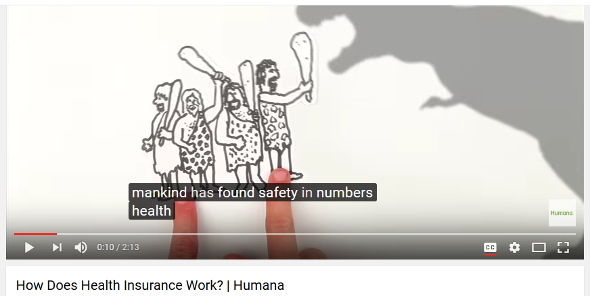
A quick, high-level explanation from a major healthcare insurer…
https://www.youtube.com/watch?v=Mgz4FOvlYgA

Slide 11
What else should be know in general?
The governing principal of private insurance is to make a profit for the company — their “caring” may be genuine, but has to also be a means to profit
Insurance companies only make profit if “payouts” are be less than the “premiums” collected from everyone with policies
To make these profits, insurance companies must balance four factors:
How many policies are in force
How sick the people are with those policies
How much they agree to pay to medical providers under agreements made
How much they charge customers for new or renewed policies—these prices are set using complicated probabilities based on historical data of who gets sick and how sick they get
…these are always highly advantageous to the insurance companies

Slide 12
What else should we know in particular?
Medical insurance only helps to pay some of a person’s medical bills
How much it helps and for how many conditions it pays depends on the cost of the insurance
High-cost policies cover more
Lower-cost (but still expensive!) policies cover less
Individuals with insurance must still pay many costs
Premiums – Cost of the plan, paid monthly, whether sick or not
Deductibles – The annual amount you must pay for medical care before your plan will pay anything
Co-pays & Co-insurance – How much you must pay for each instance of medical care when that care is covered by your plan and your annual deductible has been paid.
All costs for services that are not covered by their policy (i.e., “out of network” costs)
These vary a lot between policies & between insurers

Slide 13
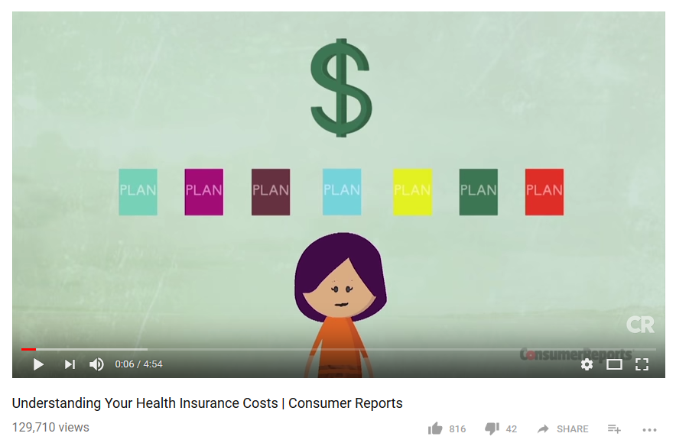
How much does insurance cost?
A great primer on the vocabulary of healthcare insurance…
https://youtu.be/DBTmNm8D-84

Slide 14
An example of medical costs for an insured individual with an HDP* in a single month…
* High-Deductible Plan
$250 – Cost of monthly premium
You must pay this without fail, whether you use the insurance or not!
Does not count toward your high deductible
$150 – Price paid for monthly asthma medication
Medications often cost a lot less ($5), or a lot more ($900) than this
$650 – Total charges from the urgent care center and the radiologist for diagnosis and treatment of your sprained wrist
You will pay full price for all services until you have paid your deductible in full for that year. High deductibles can range from $1K-$15K+
Only after you have “met your deductible,” will you begin to pay lower fees for physician visits, prescriptions, etc.
Until then, the only benefit your HDP insurance provides is to guard you against catastrophic bills resulting from a serious illness or injury (along with needed preventative care).

Slide 15
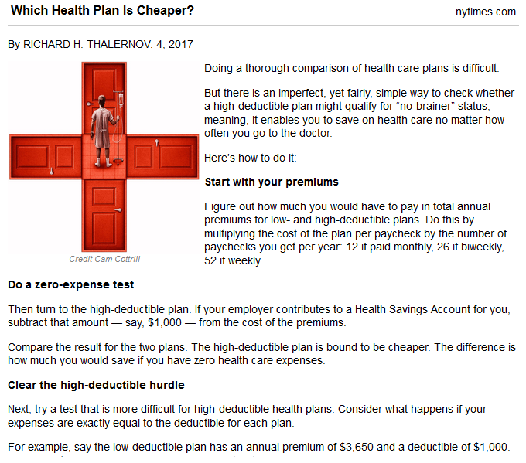
Comparison shopping is tough!
https://nyti.ms/2hEqw1w

Slide 16
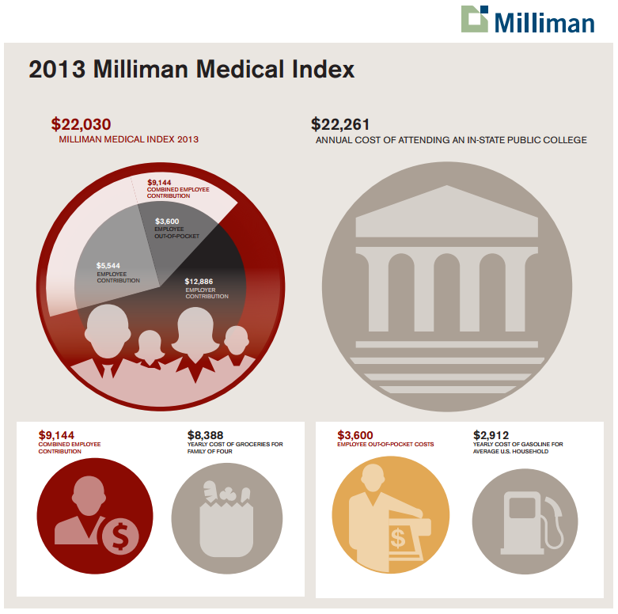
What’s so tough about the issue? Insurance Doesn’t Pay Everything
To stay healthy in America, medical insurance is a “must”
With insurance, medical bills are still very hard to pay for an average middle-class family of 4
Without insurance, those same medical bills can consume 25-50% of that average middle-class family’s income
Comparison
Comparison
Comparison
http://www.forbes.com/sites/danmunro/2013/05/22/annual-healthcare-costs-surpasses-22000/

Slide 17
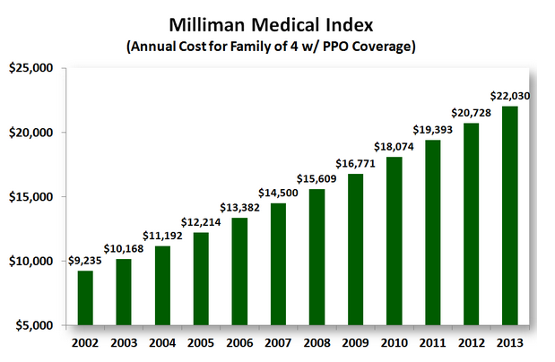
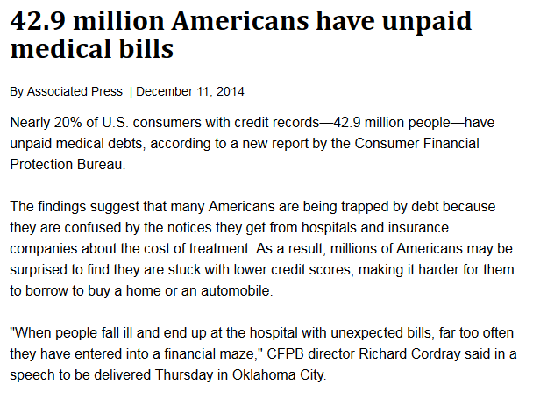
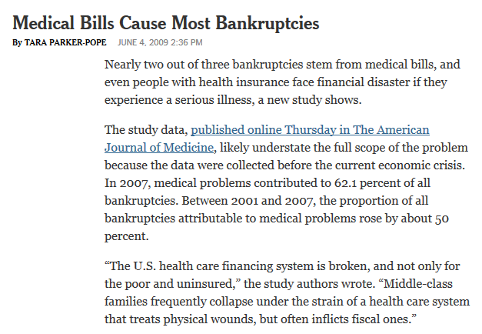
What’s so tough about the issue? High Costs Keep on Rising
Medical care costs are also increasing rapidly, making it even more impossible to pay cash for necessary care with each passing year
Increase of $12,000+
Only 12 years!
http://www.modernhealthcare.com/article/20141211/NEWS/312119987
http://well.blogs.nytimes.com/2009/06/04/medical-bills-cause-most-bankruptcies/
http://www.forbes.com/sites/danmunro/2013/05/22/annual-healthcare-costs-surpasses-22000/

Slide 18
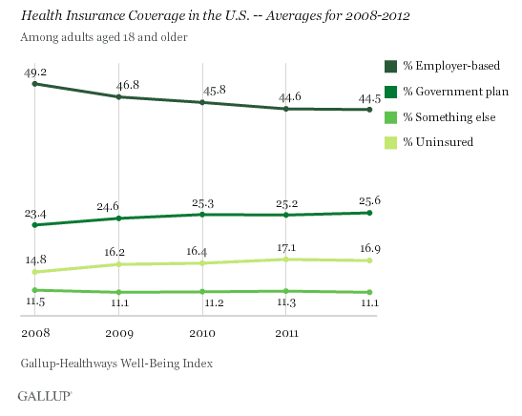
What’s so tough about this issue? Fewer Jobs with Medical Benefits
U.S. employers, the #1 source of healthcare benefits, scaled back the number of jobs they offered between 2008 and 2012 that included a medical care plan
http://www.gallup.com/poll/160676/fewer-americans-getting-health-insurance-employer.aspx

Slide 19
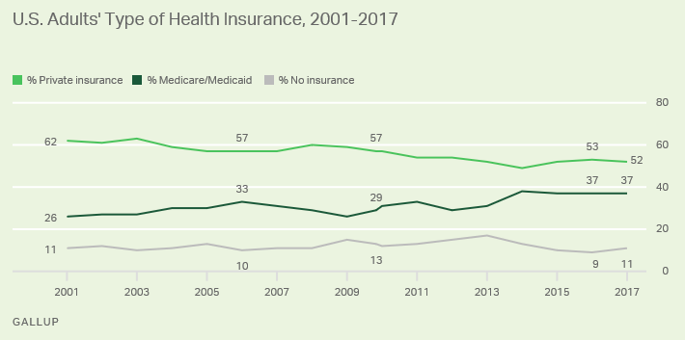
What’s so tough about this issue? Fewer Jobs with Medical Benefits
U.S. employers, the #1 source of healthcare benefits, scaled back the number of jobs they offered between 2008 and 2012 that included a medical care plan
https://news.gallup.com/opinion/polling-matters/223577/pays-americans-health-insurance.aspx?g_source=link_NEWSV9&g_medium=TOPIC&g_campaign=item_&g_content=Who%2520Pays%2520for%2520Americans%27%2520Health%2520Insurance%3f

Slide 20
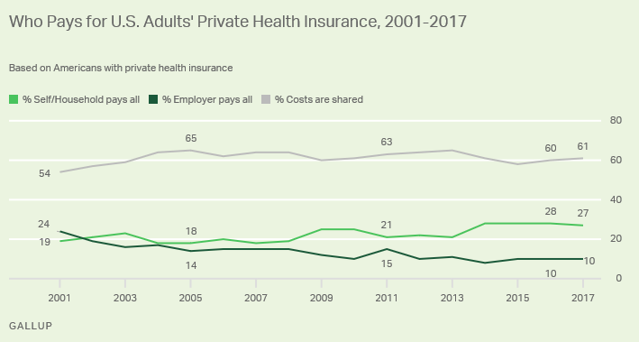

What’s so tough about this issue? Fewer Jobs with Medical Benefits
U.S. employers, the #1 source of healthcare benefits, scaled back the number of jobs they offered between 2008 and 2012 that included a medical care plan
https://news.gallup.com/opinion/polling-matters/223577/pays-americans-health-insurance.aspx?g_source=link_NEWSV9&g_medium=TOPIC&g_campaign=item_&g_content=Who%2520Pays%2520for%2520Americans%27%2520Health%2520Insurance%3f

Slide 21
What’s so tough about this issue? Fewer Jobs with Medical Benefits
U.S. employers, the #1 source of healthcare benefits, have tended to scale back the number of jobs they offered since 2001 that included a medical care plan
They also are tending to pay less of the cost of those plans, shift more of the burden onto their employees
So which jobs don’t usually include medical benefits?
Part-time positions
Contractor positions
Then there are also full-time positions that only offer very expensive medical benefits or poor-quality plans
Businesses get to choose how much (or little) they will contribute to the insurance bills
By choosing poorer quality plans, they also lower their own costs
http://www.gallup.com/poll/160676/fewer-americans-getting-health-insurance-employer.aspx

Slide 22
Practice Problems …to begin mastering this material. Complete instructions are in the Module 1 resource, How to Use Practice Problems to Prepare for Exams.
Don’t forget to do the…

Slide 23
Please complete the University Course Eval! https://tamu.aefis.net
Should take only 2-10 minutes, depending on whether you are willing to leave comments, too. I hope you will, and the more specific, the better.
My Promise: If you leave comments, I WILL READ them. Previous student comments have led me to change my course design in big and small ways.

